Slide 1
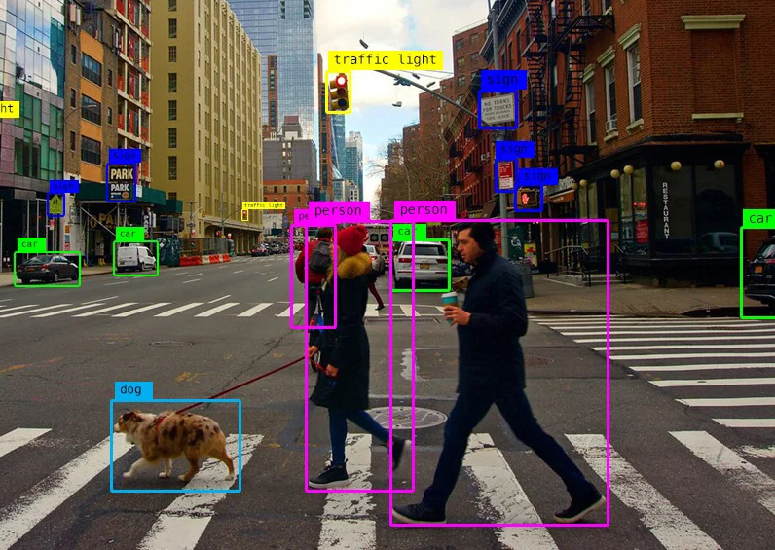
Advance Topics in Deep Learning: Deep Computer Vision
By: Dr. Zafar Mahmood Khattak, PhD (AI)

Slide 2
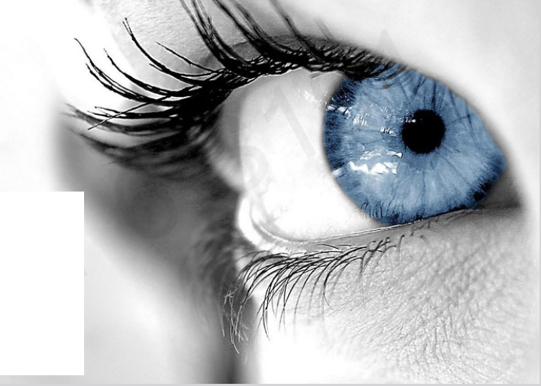
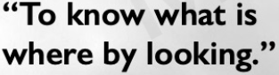
Deep Computer Vision
How to build computer that can achieve the sense of sight and vision
Vision, one of the most important human senses that we all have.
characteristics of sighted peoples……..
The outcome of this topic is to learn how we can use deep learning & machine learning to build powerful vision systems that can both see and predict what is where by only looking at raw visual inputs.

Slide 3
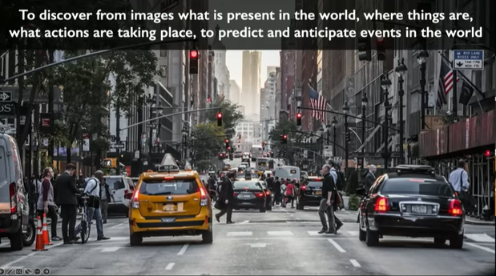
Vision is much more than understanding what is where

Slide 4
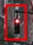
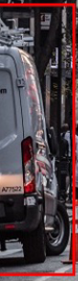
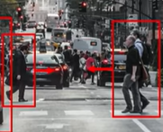
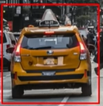
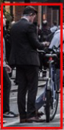
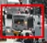
Vision is much more than understanding what is where

Slide 5
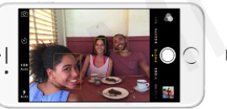
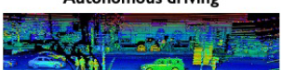
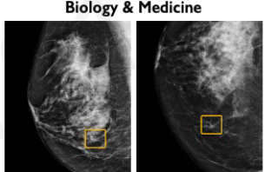
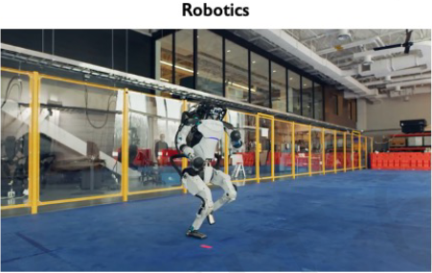

The rise and impact of impact of Computer Vision

Slide 6
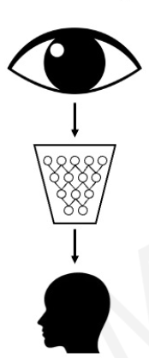
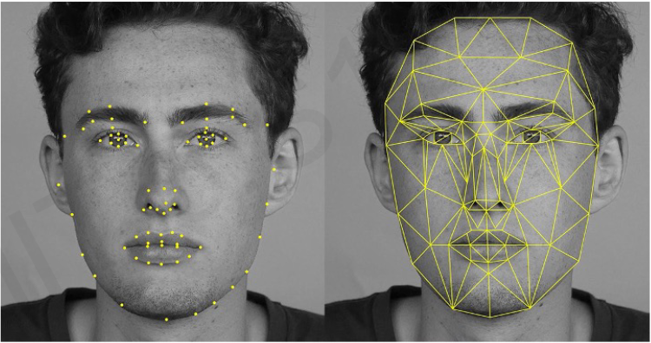
Impact: Facial Detection and & Recognition

Slide 7
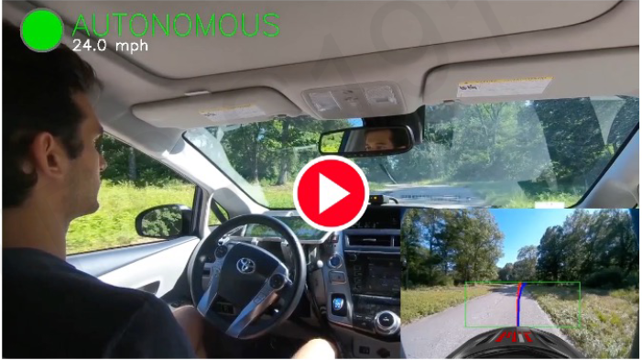
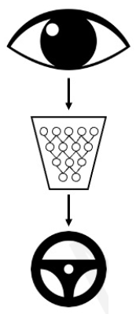
Impact: Self-Driving Cars: a go-to example

Slide 8
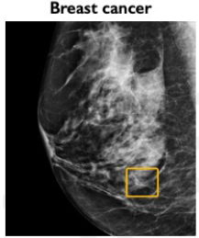
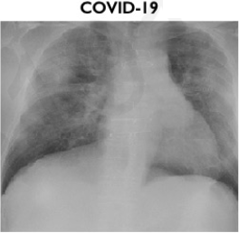
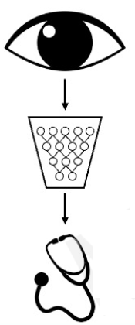
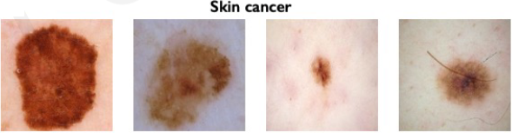
Impact: Medicine, Biology, Healthcare

Slide 9
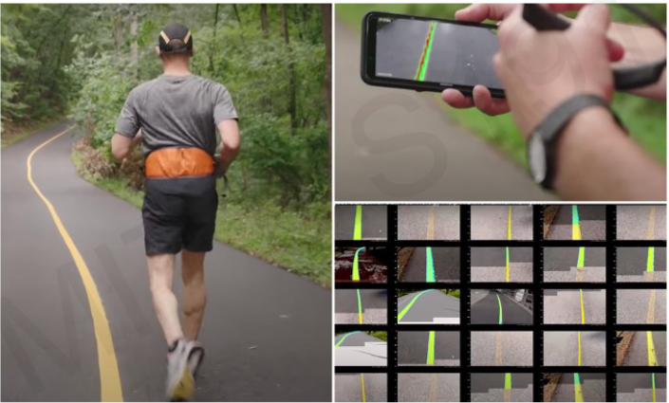
Impact: Medicine, Biology, Healthcare

Slide 10

What Computer “see”

Slide 11

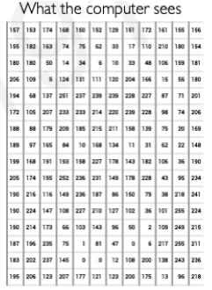
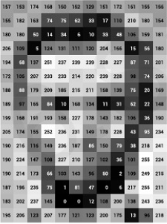
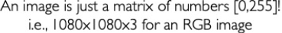
How images are Represented in Computer?
Grayscale image
How the representation if we have a color image?
1 no for pixel or 3 no for pixel
1-2D Matrix or 3-2D Matrix
2-D Matrix of Numbers

Slide 12

How images are Represented in Computer?

Slide 13
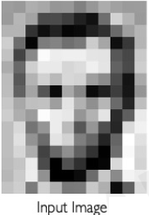
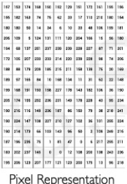
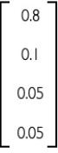
Processing in Computer Vision
What types of computer vision algorithm that we can build to take this as input to predict an image
Zavyar
Wildan
Amir
Rovaid
Classification: Predict/classify output as a discrete class label such as Male or Female, True or False, Spam or Not Spam, etc.
Regression: Predict output as continuous values such as price, salary, age, etc.

Slide 14

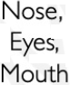

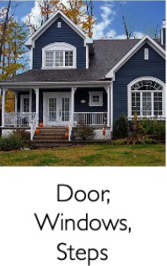
High Level Feature Detection: Image Processing in terms of features or patterns
If we have to build a computer vision pipeline, two important steps to be considered: identify feature/patters looking for,
Detect those features to infer the membership of the class

Slide 15

High Level Feature Detection: What we Need
What makes up a face
We can define what of each of those components/features look like
We can define what of each of those components/features look like in defining our features
What are the issues Problem while extracting the features?

Slide 16
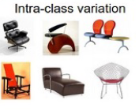
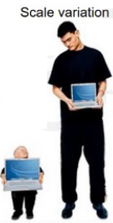
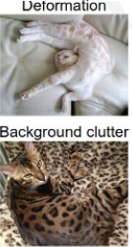
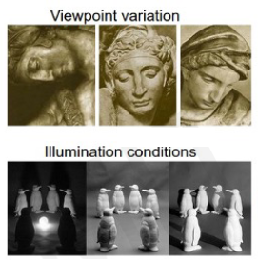
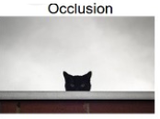
High Level Feature Detection: Remember Images are just 3-D arrays of numbers

Slide 17

Lets Revised concept of Neural Network Lecture for features extraction

Slide 18


Slide 19
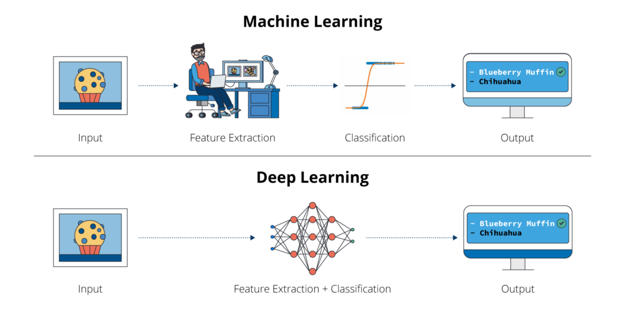

Slide 20
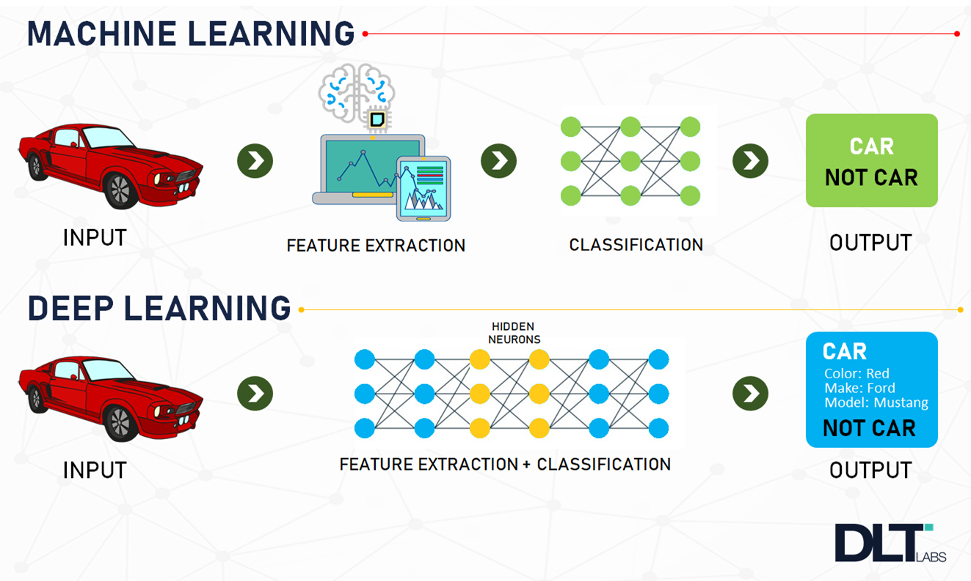

Slide 21
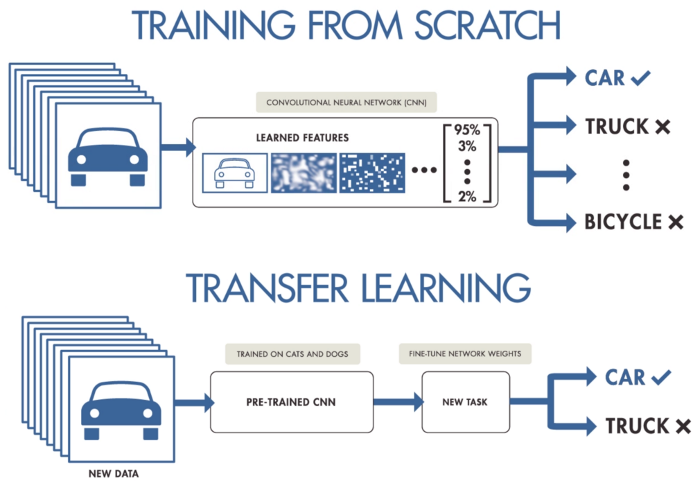

Slide 22
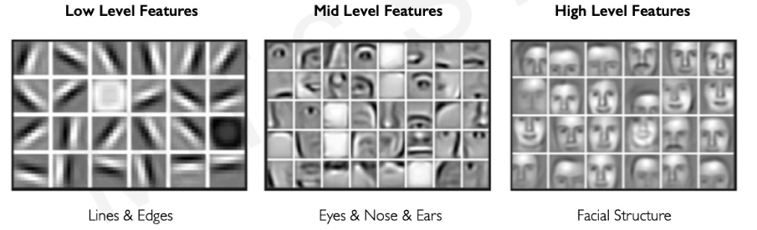
learning Features Representation Neural Network Lecture)
Can we learn a hierarchy of features directly from the data instead of hand engineering?
How Machine Learning deals with such types of images?

Slide 23
How to detect Features and Patterns in an image?
Time consuming
Hard to do
Not scalable in practice

Slide 24
Key Idea of Deep Learning:
No Human intervention
Machine extract and uncover the core patterns in the data and then
Decision/prediction on new data/sample
Example of detecting faces in image using DLNN:
detect edges
Detect line and edges
Combine to create composition of features (curves and corners) results in
High level features (eyes, nose, eras etc.)
Hierarchical learning of features
Progression of information
Face detected
Solution is :::
Deep learning Algorithms (Neural Network)

Slide 25
Learning visual Features
How Neural network Extract hierarchical features in the image Domain? And Most Importantly
How Neural network allows us to learn those visual features from visual Data if cleverly constructed!!!

Slide 26
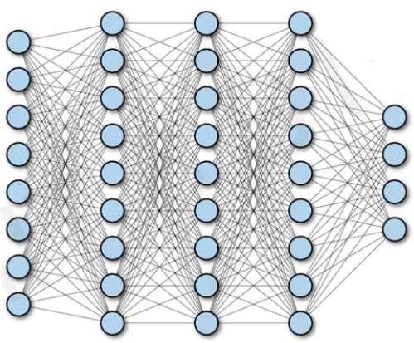
Fully Connected Neural Network

Slide 27
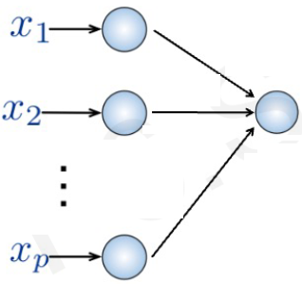
Fully Connected Neural Network
Fully Connected:
Connect Neuron in hidden layer to all neurons in input layer
No spatial Information (3-D or 4-D)
Large no. of parameters, as the system is fully connected
Input:
2-D Image
Collapsing into 1-D sequence of number (Vector of pixel values)
Remember that our image is just 2-D array
Fully connected NN can’t process 2-D Matrix

Slide 28
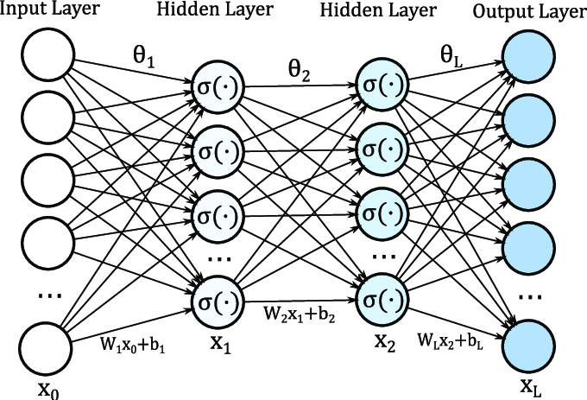
Fully Connected Neural Network
How can we use spatial structure in the input to inform the architecture of the network?

Slide 29
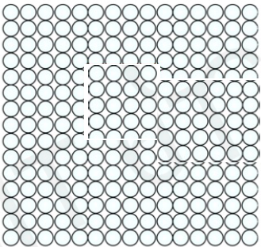
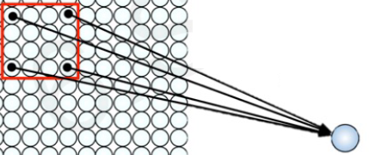
Using Spatial Structure
Input:
2-D Image
Collapsing into 1-D sequence of number (Vector of pixel values)
Idea: connect patches of input to neuron in hidden layer
Neuron connected to region of input, only sees the values

Slide 30
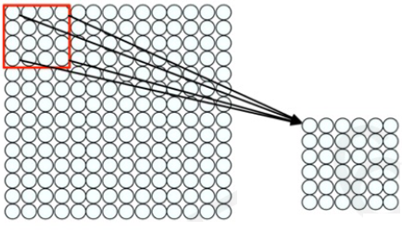
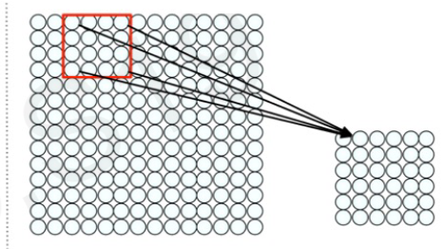
Using Spatial Structure
Connect patch in input layer to a single neuron in subsequent layer by using a sliding window to define connections, and thus preserving very rich spatial information.
How we can weight the patch to detect particular patch?

Slide 31
Applying Filters to Extract Features
Apply a set of weight - a filter – to extract local features
1
Use Multiple filters to extract different features.
2
Spatially share parameters of each filter
3

Slide 32
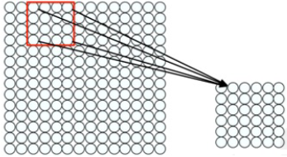
Features Extraction with Convolution: An Example
Filter of size 4*4= 16 different weights
Apply this same filter to 4*4 patches in input and use the result of that operation to update the state of the neuron in the next layer
Shift by 2 pixel for next patch to define the next neuron in the adjacent location in the future layer
Concept of Convolution at high level

Slide 33
Feature Extraction and Convolution: A Case Study
How convolution allows us to learn these features/patterns in the data which is our ultimate goal

Slide 34
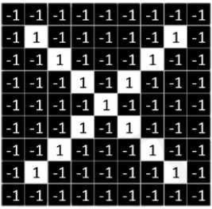
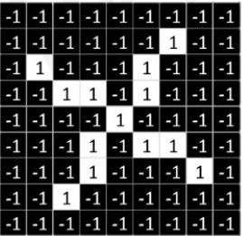

Designing a Convolutional Algorithm to Detect or Classify X as X in a Black & White Image
No Grayscale image, black and white (1-white and -1 for black)
Detect x in both of these images slightly rotated
Cleverly we have to detect those feature that define an X: So let see how to use Convolution to do that

Slide 35

Identifying Features of X using Convolution
We need our model to compare images of this X, piece by piece or patch by patch and the important patches that we look for are exactly these features that will define our X:
If our model can find these rough features roughly in the same position in our input than we can infer that these two images or of the same type

Slide 36




Identifying Features of X using Filters
These smaller matrices are Filter of weights or jus numerical values of each pixel in these mini patches
In the case of X’s these filters may represent semantic things for example the diagonal lines or the crossing that captures all of the important characteristics of the X
Probably we will capture these features in the arms and the centers of our letter in any image of X regardless of its position

Slide 37

The Convolution Operation: Another Example:
Element wise Multiplication between the Filter Matrix those mini patches as well as the patch of our input image

Slide 38
The Convolution Operation: Another Example:

Slide 39

Lets see how NN and CNN Process an Image
Feed the pixels of the image in the form of arrays to the input layer of the NN
Multi-layer networks used to classify things.
The hidden layers carry out feature extraction by performing different calculations and manipulations.
There are multiple hidden layers like the convolution layer, the ReLU layer, and pooling layer, that perform feature extraction from the image.
Finally, there’s a fully connected layer that identifies the object in the image.

Slide 40

Lets see how NN and CNN Process an Image

Slide 41

Lets see how NN and CNN Process an Image
In CNN, every image is represented in the form of an array of pixel values.
Let’s understand the convolution operation using two matrices, a and b, of 1 dimension.
a = [5,3,2,5,9,7]
b = [1,2,3]

Slide 42

Lets see how NN and CNN Process an Image
a = [5,3,2,5,9,7]
b = [1,2,3]

Slide 43

Lets see how NN and CNN Process an Image

Slide 44

How CNN Recognized Image

Slide 45

The Convolution Operation: Lets Consider one More Example:
Suppose we want to compute the convolution of a 5*5 image and 3*3 filter
We slide the 3*3 filter over the input image, element-wise multiply, and add the output
To compute the convolution we have to slide this image over the filter piece by piece and comparing the similarity or the convolution of this filter across this image

Slide 46


The Convolution Operation: Lets Consider one More Example:
We slide the 3*3 filter over the input image, element-wise multiply, and add the output
The resultant 4 is placed into the next layer, which is again another image as a result of convolution operation

Slide 47



The Convolution Operation: Lets Consider one More Example:
We slide the 3*3 filter over the input image, element-wise multiply, and add the output
Simple slide over the previous filter to the next location which provide the next value in our image:
keep repeating this process over again and again until we have covered our filter over the entire image and filled the output feature map

Slide 48


The Convolution Operation: Lets Consider one More Example:
We slide the 3*3 filter over the input image, element-wise multiply, and add the output

Slide 49


The Convolution Operation: Lets Consider one More Example:
We slide the 3*3 filter over the input image, element-wise multiply, and add the output

Slide 50


The Convolution Operation: Lets Consider one More Example:
We slide the 3*3 filter over the input image, element-wise multiply, and add the output
After discussing the mechanism that define the operations of convolution, let see how different filter could be used to detect different types of patterns in our data

Slide 51

Convolution Operation Simulation for Grayscale image

Slide 52


Slide 53




Producing Feature Map
If we apply 3 different filters to detect different type of features
Apply 3*3 filter to see the drastic change in the image just by changing the weights that are present in 3*3 matrices :

Slide 54
Features Extraction with Convolution
Apply a set of weight - a filter – to extract local features
Use Multiple filters to extract different features.
Spatially share parameters of each filter

Slide 55
Convolutional Neural Networks (CNNs)
After understanding the basic operation of Convolution, patching, sliding, and feature map, lets think to extend the singular convolution operation to the entire layer
To Discus the Architecture of CNN: Which is the core of this topic

Slide 56

Simple CNNs for Classifying an Image
Main task: To extract feature directly from the raw data and use these learn features for classification or detecting an object
Thee main Operations of CNN:
1- Convolution:
2- Non-linearity:
3- Pooling:

Slide 57

Simple CNNs for Classifying an Image
Main task: To extract feature directly from the raw data and use these learn features for classification or detecting an object
Finally feeding all of these resulting features to some NN to infer the class score

Slide 58

Non-linearity Operation
ReLU performs an element-wise operation and sets all the negative pixels to 0.
It introduces non-linearity to the network, and the generated output is a rectified feature map

Slide 59

So for the structure

Slide 60

Building Basic Architecture of CNN: Convolutional Layers (Local Connectivity)
For neuron in hidden Layers:
Take input from patch
Compute weighted sum
Apply bias
Finally feeding all of these resulting features to some NN to infer the class score
A very special point is the local connectivity, where every single neuron in this hidden layer only sees a certain patch in its previous layer

Slide 61

Building Basic Architecture of CNN: Convolutional Layers (Local Connectivity)
Now lets define the actual computation that going on for a neuron in a hidden layer, its inputs are those neuron that fell with its patch in the previous layer
Convolution is about:
Element-wise multiplication operation
Addition operation
Sliding operation
Provide basis for layers that define how neurons in the convolutional layers are connected and how they are mathematically formulated.
Computation at Neuron:
- applying matrix of weights
Computing linear combinations: do element-wise multiplication, add the output and apply the bias
Apply the non-linearity (activate the neuron with non-linear function)

Slide 62

Building Basic Architecture of CNN: Convolutional Layers (Local Connectivity)
Layer dimension:
h x w x d
Where h and w are spatial dimension and d(depth) is the no of filters
Stride
Filter step size
Receptive Field:
Location in input image that a node is path connected to
What We need to think of is actually convolutional operations that can output a volume of different images, and
Every slice of this volume effectively denotes a different filter that can be identified in our original input and each of those filter is going to basically correspond to a specific pattern or feature in our image

Slide 63

Stride
Stride
Filter step size
Some times we do not want to capture all the data or information available so we skip some neighboring cells let us visualize it,
Here the input matrix or image is of dimensions 5×5 with a filter of 3×3 and a stride of 2 so every time we skip two columns and convolute, let us formulate this

Slide 64


2nd Key Operation in CNN: Introducing Non-Linearity
Take those resulting feature map that our convolutional layer extract and apply the non-linearity to the output volume of the convolution layer
. Apply after every convolution operation (after convolutional operator)
. Non-linear operation: ReLU ( pixel by pixel operation that simply returns 0 if your value is negative else it returns the same value you give
Negative values indicate the negative detection in convolution (no detection

Slide 65

3rd Key Operation in CNN: Pooling
Main purpose off pooling: To reduce the dimensionality of the image progressively as you go deep & deeper, through you convolutional layers (decreasing the dimensionality of the features increasing the dimensionality of the filters)

Slide 66

3rd Key Operation in CNN: Pooling (Max, min, Avg)

Slide 67

Representation Learning in Deep CNNs
So now put them altogether: Convolution layer, Non-linearity and polling to form and construct a CNN in a repeating way over and over again to learn these hierarchies of features

Slide 68

CNN for image Classification: Feature Learning
So now put them altogether: Convolution layer, Non-linearity and polling to form and construct a CNN in a repeating way over and over again to learn these hierarchies of features: Two Parts
Feature learning pipeline: to learn the features that we want to detect and Detecting those feature and doing the classification
1. Learn features in input image through Convolution
Introduce Non-Linearity through activation function (as the real-world data is non-linear)
Reduce dimensionality and preserve spatial invariance with pooling

Slide 69


CNN for image Classification: Feature Learning
Feature learning pipeline: to learn the features that we want to detect and Detecting those feature and doing the classification
The goal of Convolutional and pooling layer is to output high-level features that are extracted from the input
2. Fully connected layer uses these feature to detect their presence in order to classify the input image
3. Express output as probability of image belonging to a particular class
The softmax function is just a normalizing function whose output represents that of a categorical probability distribution

Slide 70

CNN for Classification: Feature Learning
So now put them altogether: Convolution layer, Non-linearity and polling to form and construct a CNN in a repeating way over and over again to learn these hierarchies of features

Slide 71



CNN for Classification: Feature Learning

Slide 72



CNN for Classification: Feature Learning

Slide 73
An Architecture for Many Applications
After getting the basics of how to use CNNs to perform image classification task, remember that the same architecture can be extend to so many application and model types that we can imagine

Slide 74

An Architecture for Many Applications
When we consider CNN for image classification: Two parts,
1. Feature extraction learning (feature of interest)
2. Detection of those features and classification

Slide 75

Classification: Breast Cancer Screening

Slide 76




Object Detection
This is not easy as that, if our scene contains multiple objects: In that case our NN model should be able to infer a dynamic no of objects

Slide 77




Object Detection
Predicted classification labels independently to each class
If we want to detect a taxi only its no problem, but if the image contains different objects of different classes, and our model need to draw a bounding box for each objects of different class is quiet complicated in practice:: A naive solution to object detection

Slide 78





A Naive Solution to Object Detection
Problem: too many potential inputs, this results in too many scales, position and size,,,,,, totally impractical to run in real life application with today computers

Slide 79





Object Detection Using R-CNN: Instead of picking random boxes use a simple heuristic
R-CNN Algorithm: Find regions that we think have objects. Using CNN to classify
Identify meaningful object in the image and just feed in those high attention locations to our CNN to speed up the first part.

Slide 80




Faster R-CNN: Among many variance proposed for object detection
Faster R-CNN Algorithm: Which attempts to learn not only how to classify those boxes but learned how to propos those boxes might be in the first place so that you could learn how to feed or where to feed into the downstream NN

Slide 81


Faster R-CNN: Among many variance proposed for object detection
So the goal here is to directly try to learn or extract all of those key regions and process them through the later part of the model

Slide 82

Semantic segmentation : Fully Convolutional Network
In classification we saw not only to predict a single object per image, we also saw an object detection potentially inferring multiple objects with bounding boxes in you image.

Slide 83

Semantic segmentation : Biomedical Image Analysis
The same concept may be applied to so many application in healthcare especially for segmenting out lets say cancerous regions.

Slide 84


Continuous Control : Navigation from Vision Control
Lets consider we want to build a NN model for autonomous navigation for self driving car

Slide 85
Key point to remember
All these different architecture uses the exact same encoder, we haven't change anything going from classification to detection to sematic segmentation and autonomous navigation, are using the same building block
Convolution
Non-linearity
pooling

Slide 86

Concluding the CNN lecture: Deep Learning for Computer Vision : Impact

Slide 87

Deep Learning for Computer Vision : Summary

